Slide 1
Bank Marketing Campaigns
Classifying Customer Responses
A. Sardina-Spevack Module 3 Project

Slide 2

Tested different models for classifying customer behavior

Slide 3

Term Deposit Direct Marketing
The Question:
Which group did our customers fall into at the end of the initiative:
-yes — subscribed
-no — did not subscribe

Slide 4
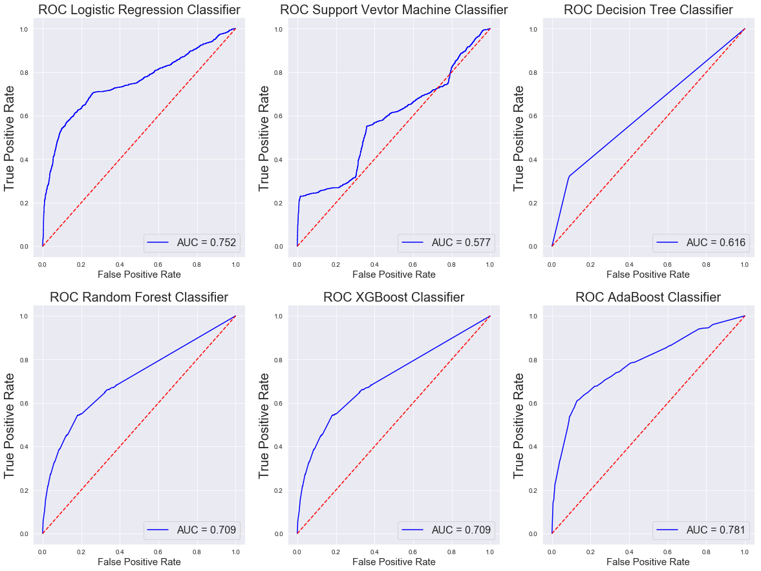
Model Selection
Six models were tested for their accuracy in correctly classifying customer behavior.
Logistic Regression
Support Vector Machine
Decision Tree
Random Forest
XGBoost
AdaBoost

Slide 5
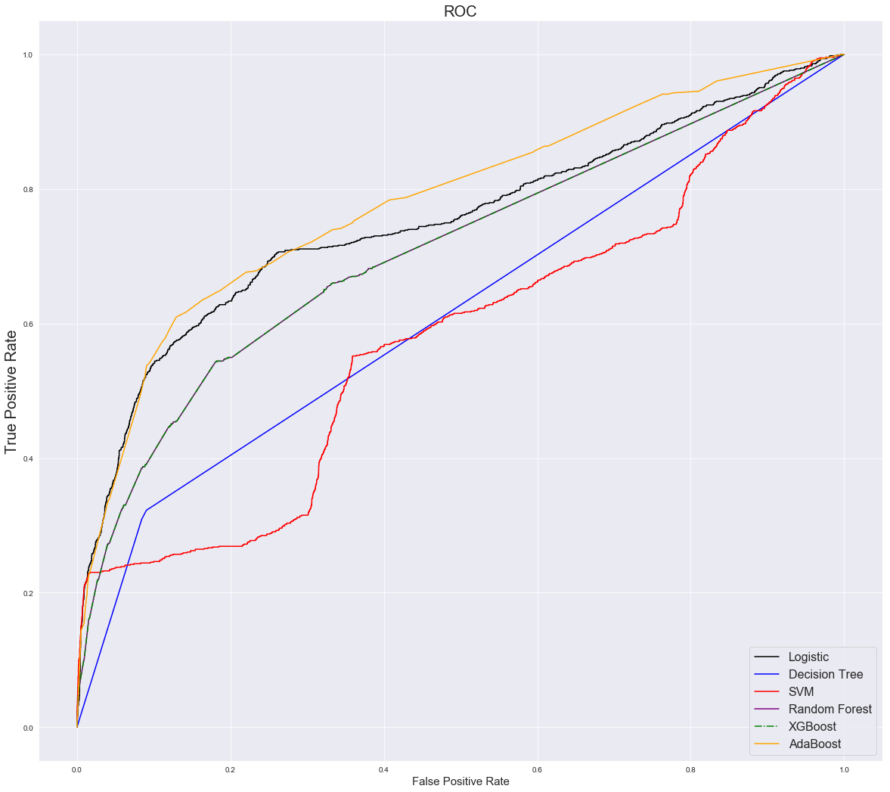
Comparative performance
Two Best Performing Models:
Logistic Regression
Precision :72.69%
Recall: 21.18%
F-1: 32.81%
AdaBoost Algorithm
Precision :65.52%
Recall: 22.47%
F-1: 33.47%
Notes:
5%, 10%, 15%, 20%, 25%

Slide 6

Business Insights
The campaign led to 4,640 new term loans out of the 41,188 customers contacted, or 11.3% success rate
Logistic Regression can correctly predict more than 73% of the time that a customer has signed up for the term deposit.
Provide a lense into the profitability of future campaign with over a 78% accuracy
Logistic Regression is efficient and relatively light on computational resources, and it outputs well-calibrated predicted probabilities

Slide 7

Possible Future Analysis
If we had additional time to research…
...full analysis on the dataset that includes duration
...address duration for only subscribed customers in a regression analysis to see if we can predict sign-up based on call time
...weigh computational efficiency against accuracy by removing the feature selection from the analysis

